Slide 1
Plant Power Want to change the world?
Notes:
Want to change the world? Poster Presentation
www.saps.org.uk
Resource 4849, Version 1.0 (Released 2023)

Slide 2
Notes:
SAPS Want to change the world? poster

Slide 3
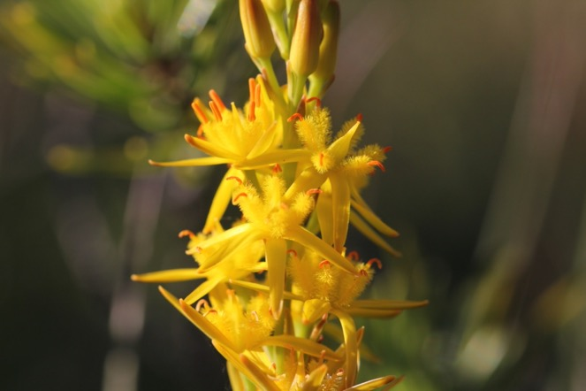
Want to change the world?
Challenges: We humans face many challenges – many of our own making.
Solutions: how you might help!
Plants offer us solutions to many of our current problems – but people are needed too! There are hundreds of jobs working with plants – directly and indirectly - which will help us solve the challenges of today in a sustainable way. Here are some of them!
Notes:
Image bog asphodel credit Anthony Short.
Refer students to the PlantPower poster ‘Want to change the world?’ and use this as a starting point for discussion of some of the major challenges facing people in the UK and globally. How aware are students of the issues and causes? How many plant-based solutions can they envisage?

Slide 4
Food security : challenges Growing enough food to feed the world – and growing it sustainably
Notes:
Photo of wheat credit Anthony Short.
Opportunity to discover what students know about main food crops. Cereals and other starchy crops such as wheat, maize (corn), rice, cassava, sweet potato and breadfruit are key crops around the world for feeding the billions of people who call this planet home. Challenges include not enough food grown, climate change affecting growing conditions, plant diseases and pests, number of people, distribution and wealth.

Slide 5
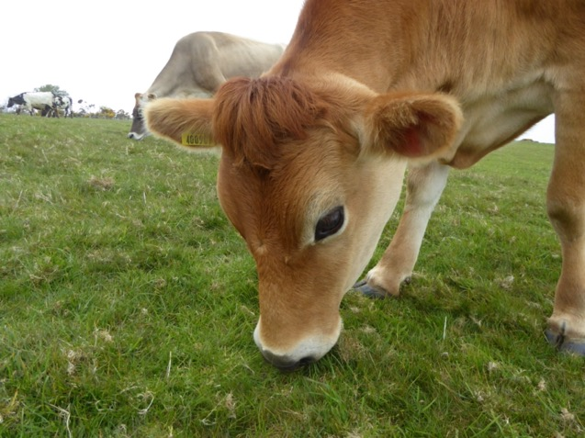
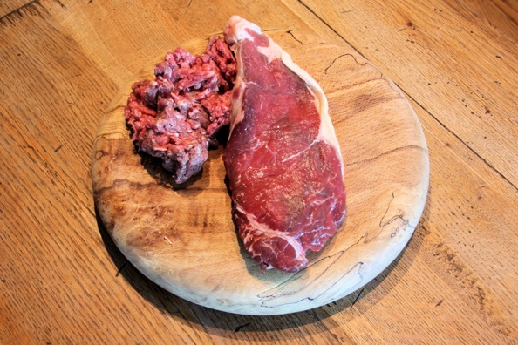
Food security : challenges Potential human food used to make animal feed
Notes:
Photo of animal feed, cow and meat credit Anthony Short.
Plant resources that could be used to feed people are turned into animal feed – even if only fields used for grazing rather than crop production. Ask students for possible solutions – and make them aware of some of the problems of over-simplification e.g. only eating plants might seem a good idea BUT in many parts of the world sheep and goats are very good at turning upland/scrubby/desert plants into first class protein – in areas where no crops could be grown.

Slide 6
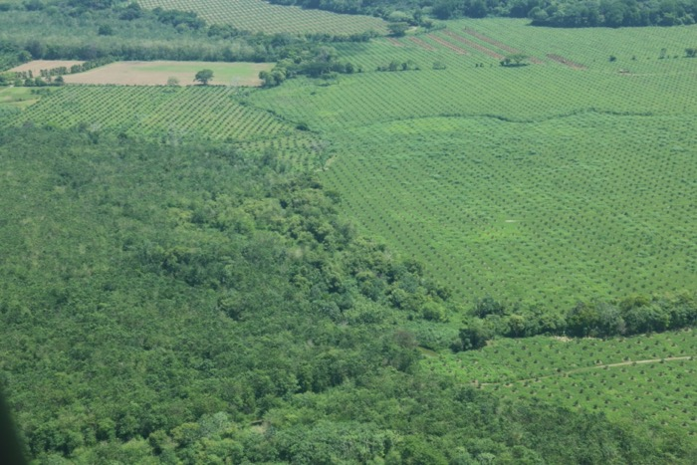
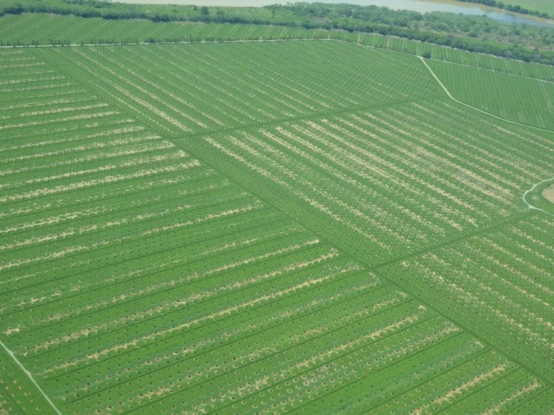
Food security: challenges Destruction of rainforest for land to grow crops – e.g. palm oil - and raise animals e.g. cattle for burgers
Notes:
Images of rainforest juxtaposed with palm oil plantations credit Anthony Short.
These aerial photographs show how rainforest – on the left of the first photo – is destroyed and the land rapidly turned into agricultural land. In these images palm oil is grown to supply the vast demand in food production. Challenge students further – palm oil is an incredibly efficient way to get oil from plants and uses less land than corn, olives, rape seed etc for the same volumes of oil… So what needs to change? Why is change hard to bring about?

Slide 7
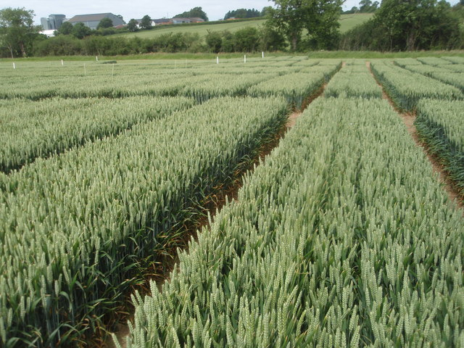
Food security: solutions Finding out how plants work, selective breeding and gene editing to make plants more productive or disease resistant all need research scientists, gene technologists, lab and field technicians alongside practical plant growers and farmers
Notes:
Image of scientist looking at bananas https://commons.wikimedia.org/wiki/File:IAEA%27s_plant_breeding_Unit_Seibersdorf_01_%287554618364%29.jpg.
Trial plots https://commons.wikimedia.org/wiki/File:Trial_Plots_-_geograph.org.uk_-_860787.jpg.
There are many careers which will help us find the solutions we need. Understanding how plants grow, and developing strains of crop plants that grow better, contain more nutrition or are more resistant to disease involves roles from high-flying academic researchers and gene technologists to planters and growers.

Slide 8
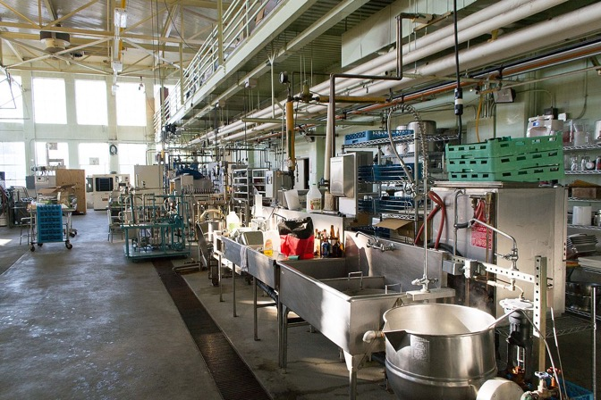
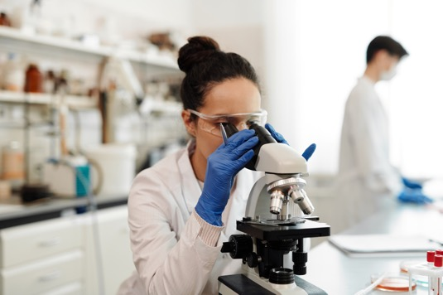
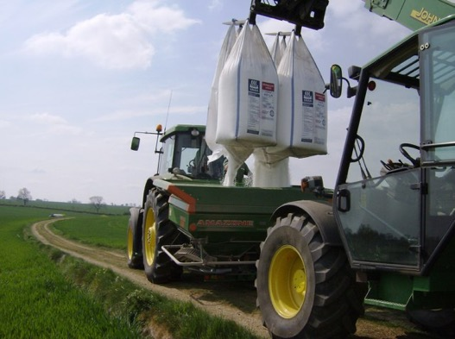
Food security: solutions Developing new plant-based foods to replace meat, modelling climate change, developing environmentally friendly fertilisers and pesticides and inspiring the next generation of biologists offer a wide range of jobs for everyone.
Notes:
https://www.pexels.com/photo/a-woman-using-microscope-4033304/
https://commons.wikimedia.org/wiki/File:Fertilising_operations_-_geograph.org.uk_-_493879.jpg
https://commons.wikimedia.org/wiki/File:Food_Science_and_Technology.jpg
Technicians in both research labs and school biology departments carry out lots of the exciting science, whilst tractor drivers and farmers trial and grow new crops. Food technology labs and factories produce new plant-based foods. For example - students could investigate the new peas being developed as an alternative to soybeans – they do not have the gene that makes them taste like peas, so the protein they produce is much more versatile!

Slide 9
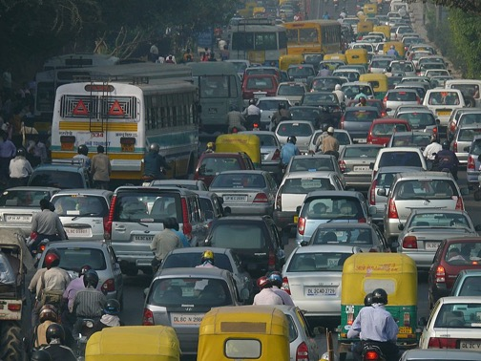
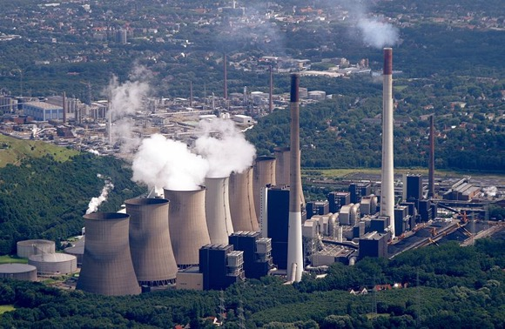
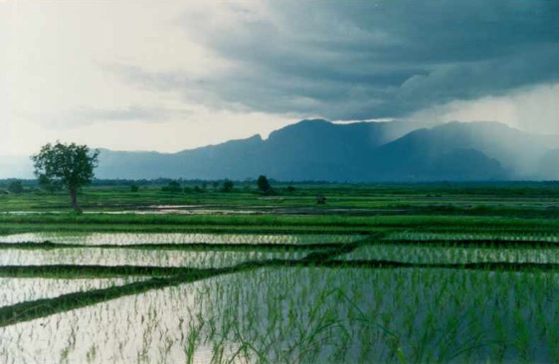
Climate change: challenges Anthropogenic climate change – caused largely by burning fossil fuels and farming cattle and rice – is affecting our ability to grow the food we need
Notes:
https://commons.wikimedia.org/wiki/Category:Traffic_congestion#/media/File:Trafficjamdelhi.jpg
https://commons.wikimedia.org/wiki/File:Uul-Rice-Fields-in-Central-Laos.jpg
https://commons.wikimedia.org/wiki/File:Scholven_Powerplant.jpg.
Most students will already be familiar with the human causes of rising carbon dioxide levels and the climate change that follows. They may not be so aware of the ways that plants can help in mitigating this risk – and the huge variety of careers in which they might get involved.

Slide 10
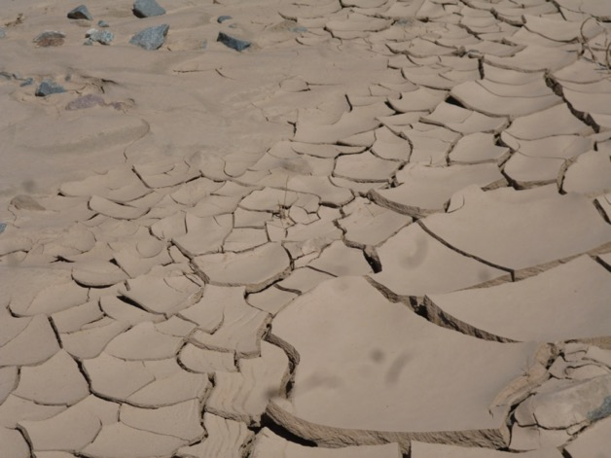
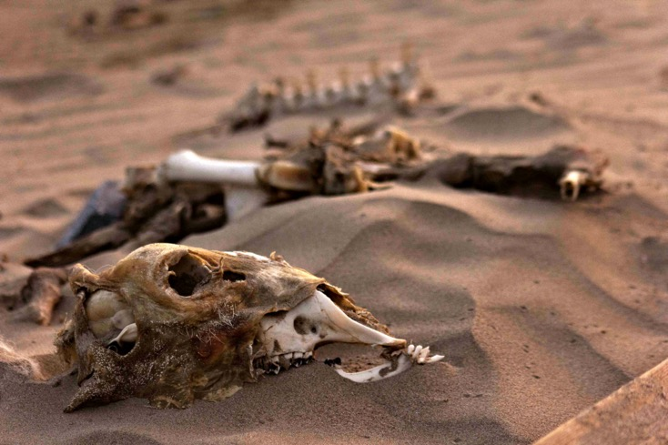
Climate change: challenges Anthropogenic climate change – caused largely by burning fossil fuels and farming cattle and rice – is affecting our ability to grow the food we need. Droughts are becoming common everywhere
Notes:
Cracked earth Credit Anthony Short.
Sheep skeleton in desert credit Edward Fullick.
One major impact of climate change is an increase in droughts – here in the UK, and across the world, with sub-Saharan Africa particularly badly affected. Discuss with students why drought is so damaging to food production – revising the needs of plants for photosynthesis and transpiration.

Slide 11
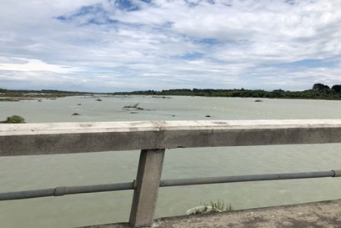
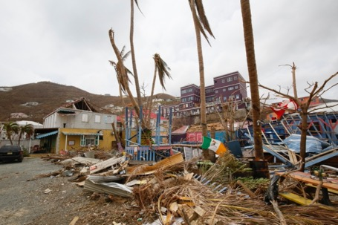
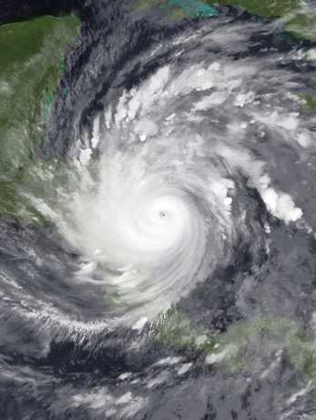
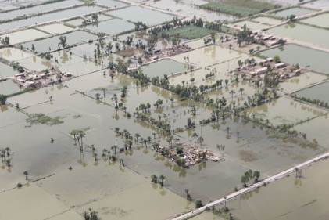
Climate change: challenges Rising sea levels and extreme weather events resulting from anthropogenic climate change are causing flooding and damage to infrastructure globally.
New Zealand
The Caribbean
Pakistan
Notes:
New Zealand floods Credit Anthony Short;
Pakistan https://commons.wikimedia.org/wiki/File:Aerial_view_of_floods,_Pakistan_2010._Photo-_Australian_Government_%2810665059503%29.jpg
https://commons.wikimedia.org/wiki/Category:Hurricane_Iota https://commons.wikimedia.org/wiki/File:View_of_damage_caused_on_by_Hurricane_Irma_in_Road_Town,_the_capital_of_the_British_Virgin_Islands._%2837376567251%29.jpg.
Floods – as catastrophic in their way as droughts – and extreme weather events of all kinds – are becoming more common as a result of climate change. Again an opportunity to revise both climate change and the requirements for healthy plants and successful agriculture.

Slide 12
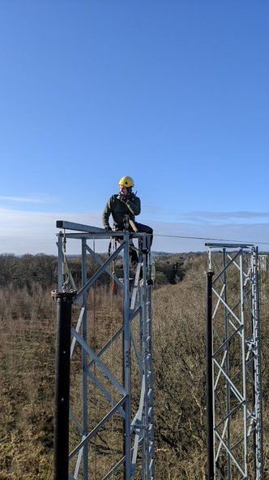
Climate change: solutions Scientific research, science technicians and gene technologists help us understand how plants respond to raised carbon dioxide levels and how we can use this knowledge.
Practical science – a 10 year
investigation into the effect of
raised carbon dioxide levels on
trees in a forest as part of the
BIFoR in a wood outside
Birmingham
Notes:
Images from Sam Dobbie s.l.dobbie@bham.ac.uk at BIFOR.
Scientists, technicians, foresters and gene technologists are all working to understand how much extra carbon dioxide plants will absorb, and how this affects their growth and health. https://canvas.bham.ac.uk/courses/52405/pages/ takes students to this exciting research and enables them to access live data

Slide 13
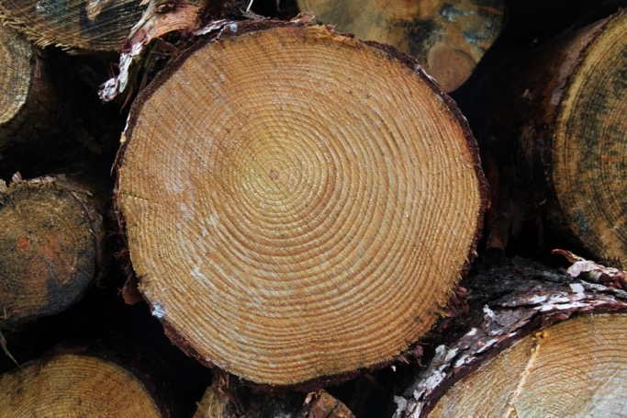
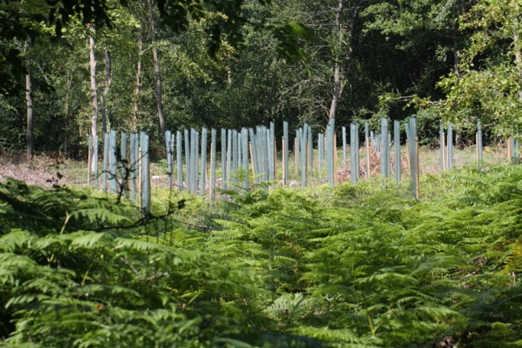
Climate change: solutions There are many roles linked to forestry, from ecological analysis and climate modelling through tree felling, planting and protecting to education, marketing and lobbying governments.
Notes:
Timber pile and tree protectors Credit Anthony Short.
This is a good opportunity to share work opportunities with or related to plants that students might not be aware of – from very practical roles working in forestry through to climate modelling and lobbying. Many of these may be roles that students are unaware of.

Slide 14
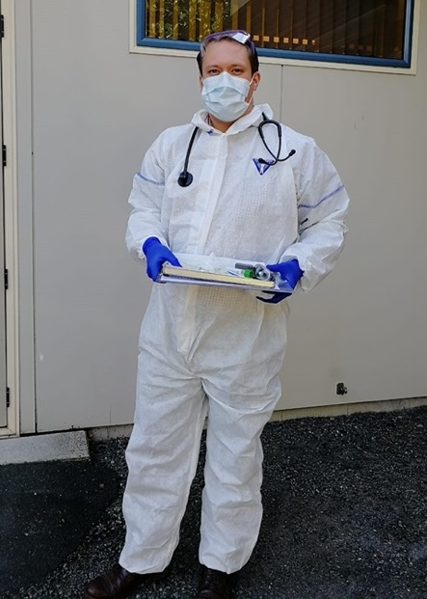
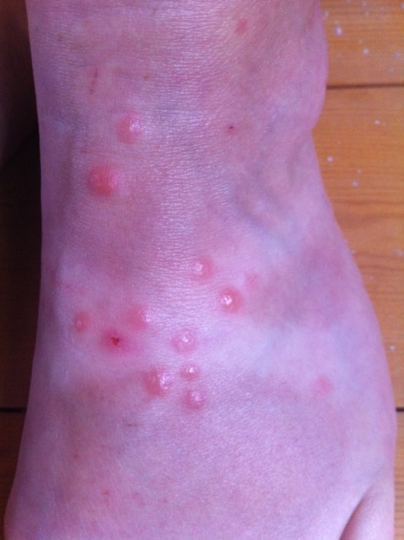
New medicines: challenges New diseases are emerging all the time – such as COVID-19 – and we still cannot treat all the diseases we do know about successfully. New medicines and new vaccines are needed all the time.
Notes:
Doctor in COVID-kit. Credit William Fullick.
Blistered leg Credit Anthony Short
Reinforces spec related points about emerging diseases and issues of treatment for both infectious and non-communicable diseases

Slide 15
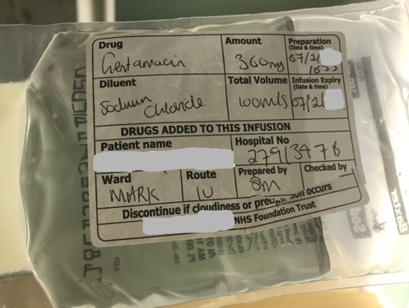
New medicines: challenges More and more bacteria are becoming antibiotic-resistant. When the medicines we rely on to treat the most serious infections no longer work, we face real problems.
Notes:
All images. Credit Ann Short.
Series of images to reinforce the issue of antibiotic resistance. Check students understand what this means – a common misconception is that the person becomes resistant to the antibiotics, not the microorganism, for example!

Slide 16
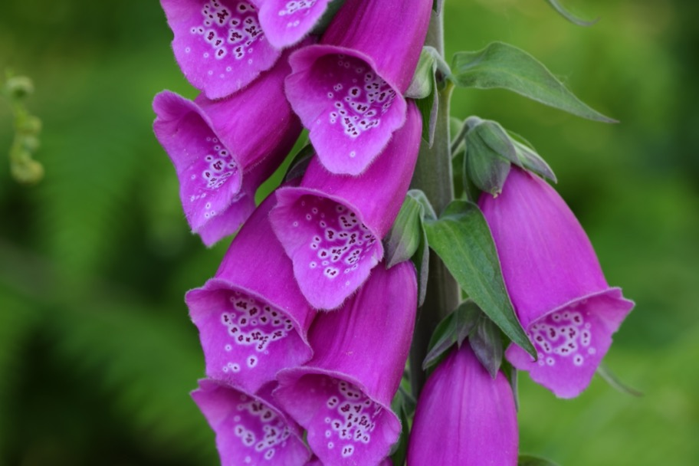
New medicines: solutions Plants like these woodland foxgloves have been a source of medicines for centuries – and compounds originally derived from plants are still used to treat many common illnesses
Notes:
Foxglove image credit Anthony Short.
Digoxin, used to treat problems with the heart rhythm, comes from the leaves of foxgloves. Taxol and related compounds used to treat breast cancer originated in yew trees. In the 21st century, around 80% of the global population rely mainly on plant-derived drugs, and around 23% of the new drugs involved in clinical trials are based on compounds originally derived from plants.
A recent report showed that in the US, at least 118 of the 150 most common prescription drugs are based on natural resources. So plants as a potential source of new medicines are extremely important.

Slide 17
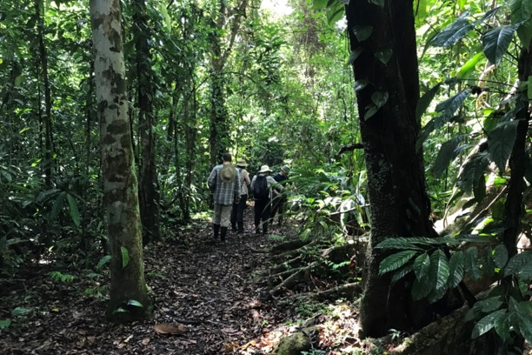
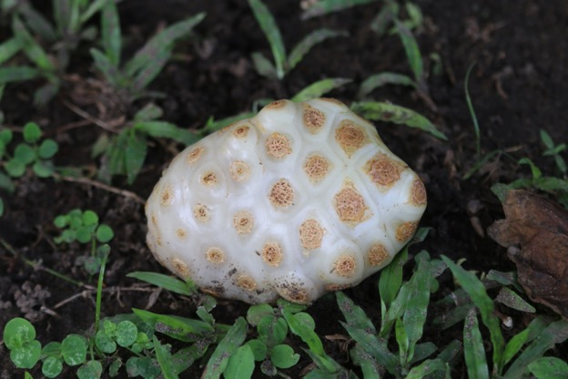
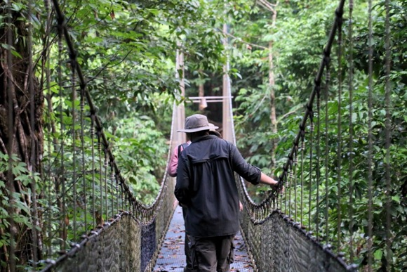
New medicines: solutions Ecologists, pharmaceutical scientists and technicians explore the world for plants – like this noni fruit – used to cure diseases – and then investigate the active compounds.
Notes:
Noi fruit and scientific expeditions Credit Anthony Short.
Plant scientists, pharmacologists and doctors still travel widely, looking for local plants used as medicines. Back home, lab scientists and technicians test to see if they work, and to discover any active compounds linked to them.

Slide 18
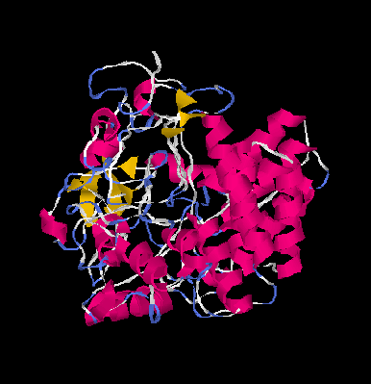
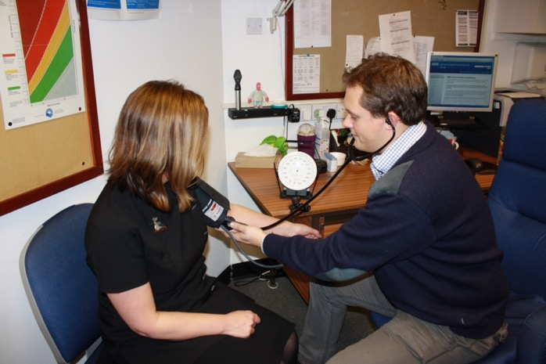
New medicines: solutions Computer scientists, programmers and modellers, and everyone involved in running clinical trials, from GPs and nurses to lab technicians and research specialists, all help develop new medicines from plants.
Notes:
Computer modelling Nikolakhs, CC BY-SA 3.0 <https://creativecommons.org/licenses/by-sa/3.0>, via Wikimedia Commons
Doctor and nurse in drug trial – Credit William Fullick.
Computer programmers and modellers play a key role in modern drug development – often taking plant-derived compounds as a starting point and modelling more effective, better targeted, less toxic compounds. Specialists in big data examine global patterns of disease and potential cures. Nurses and doctors and thousands of volunteers get involved in clinical trials to see if the new medicines work in the real world.

Slide 19
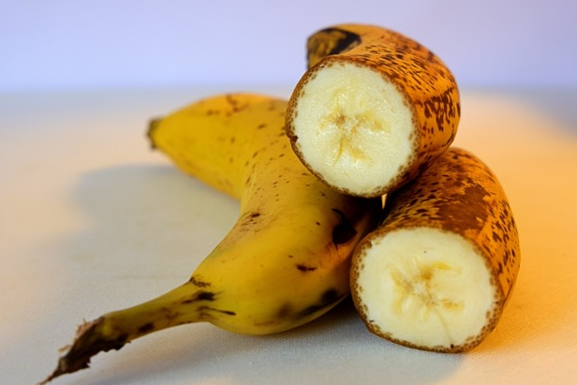
New medicines: solutions Computer scientists, programmers and modellers, and everyone involved in running clinical trials, from GPs and nurses to lab technicians and research specialists, all help develop new medicines from plants.
Notes:
DNA image Kadumago, CC BY 4.0 <https://creativecommons.org/licenses/by/4.0>, via Wikimedia Commons
Banana credit Anthony Short
Gene technologists and specialist growers are working on developing plants which grow medicines and vaccines. There are two approaches:
1 Gene edited plants which contain vaccine and drug components which are then purified and used in a traditional way.
2 Gene edited plants which contain the active vaccine component, to be eaten and so used to deliver immunisation in areas with little infrastructure, few fridges to keep conventional medicines or low numbers of healthcare workers available to deliver vaccinations.

Slide 20
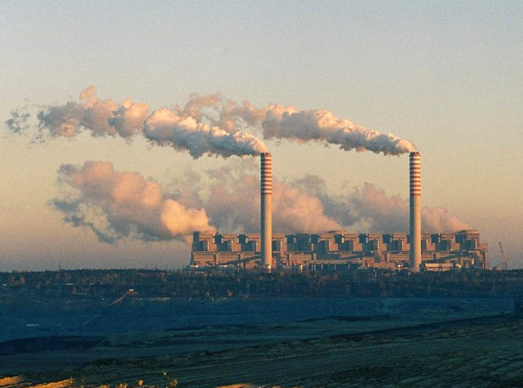
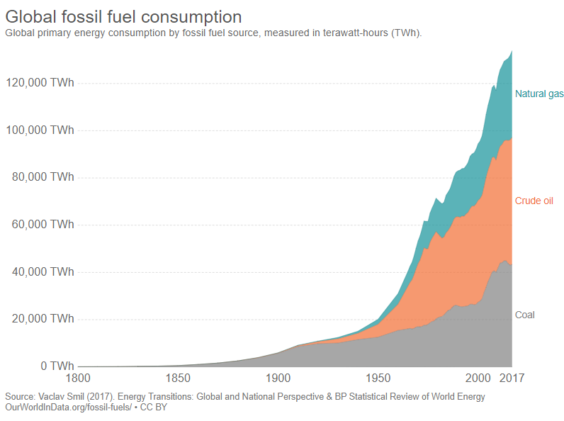
Sustainable energy: challenges To stop the rise of carbon dioxide in the atmosphere and the climate changes that go with it, we must find sustainable alternatives to fossil fuels.
Notes:
Power station https://commons.wikimedia.org/wiki/File:20051029_Belchatow_power_station.jpg
Graph https://upload.wikimedia.org/wikipedia/commons/c/cc/Global_fossil_fuel_consumption%2C_OWID.svg
Reprise of spec content on rising carbon dioxide levels as an area where urgent work is needed.

Slide 21
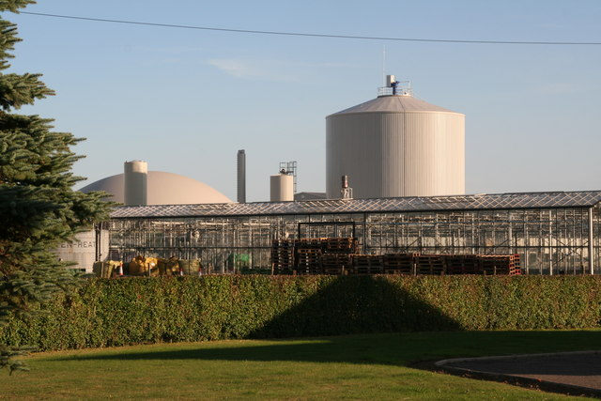
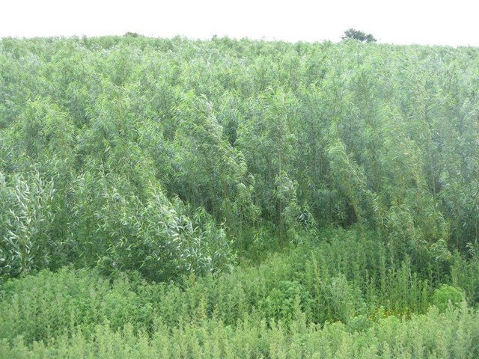
Sustainable energy: solutions Using biomass as an energy source for generating electricity needs everyone from the people growing the biomass crops to the engineers and technicians who design and run the plants.
Notes:
https://commons.wikimedia.org/wiki/File:Staples_vegetable_production_unit_and_anaerobic_digester-biogas_plant_-_geograph.org.uk_-_3684516.jpg).
https://commons.wikimedia.org/wiki/File:A_biomass_crop_of_willow_-_geograph.org.uk_-_856419.jpg.
There is a wide range of career options in finding and using sustainable alternative energy sources such as biomass crops. Great opportunity to challenge students with the dilemma – food or energy?

Slide 22
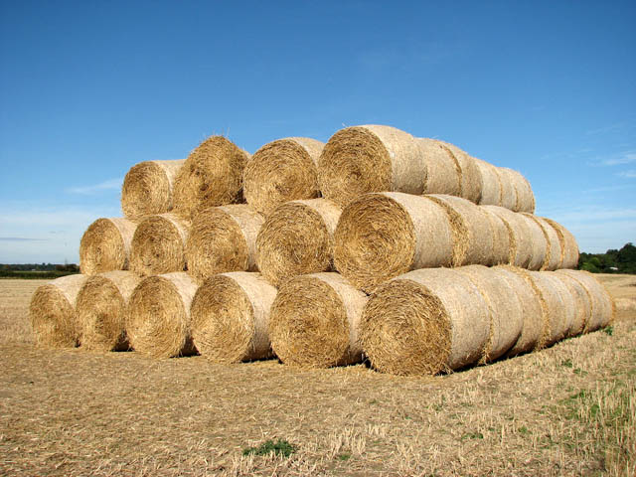
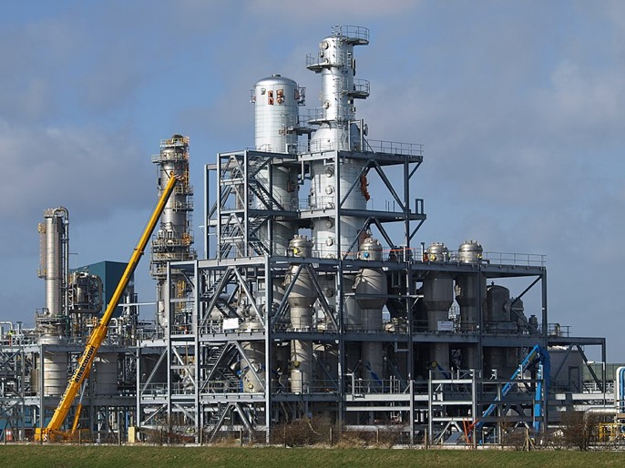
Sustainable energy: solutions Using biomass – especially waste biomass - to produce ethanol as an alternative fuel needs a diverse workforce, from plant growers and industrial technicians through research scientists and development engineers to marketing and lobbying experts.
From crop waste to a sustainable, useable fuel?
Notes:
https://commons.wikimedia.org/wiki/File:Bio_Ethanol_on_the_Way_-_geograph.org.uk_-_1773771.jpg
https://commons.wikimedia.org/wiki/File:A_stack_of_straw_bales_-_geograph.org.uk_-_1501535.jpg
Picking up the dilemma from the previous slide – opportunities to develop different technologies which use waste plant material as fuel. These range from high level science and engineering roles to less academic but nevertheless important work growing and working in industrial settings, as well as the importance of selling the idea of plant power where it matters.

Slide 23
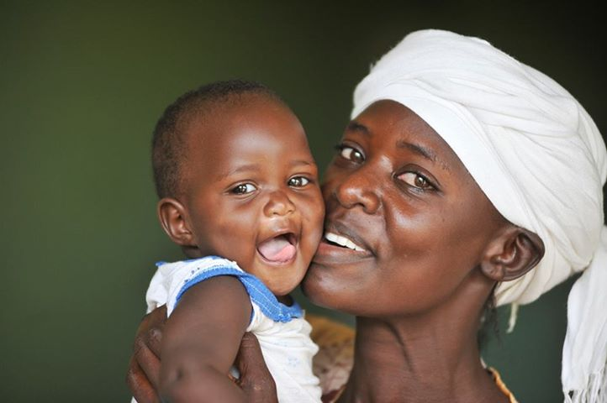
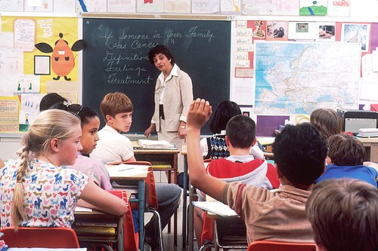
Mental health: challenges We are more aware of the importance of mental well-being than ever before – and problems with mental health affect huge numbers of people, from childhood onwards.
Notes:
https://commons.wikimedia.org/wiki/File:Depressed_%284649749639%29.jpg
https://commons.wikimedia.org/wiki/File:Children_in_a_classroom.jpg
https://commons.wikimedia.org/wiki/File:Kenya_Mother_and_Child_%289451379699%29.jpg.
This needs sensitive handling. Students will probably be well aware of mental health and wellbeing issues and the rise in reported problems. This is an opportunity to show that mental well-being is important at all ages and stages.

Slide 24
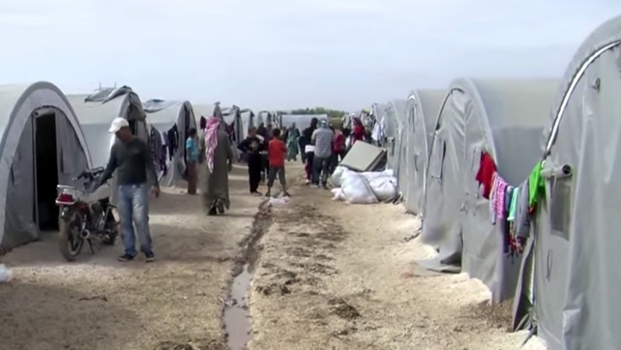
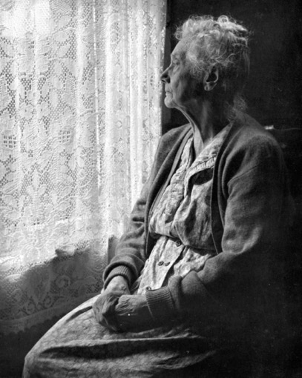
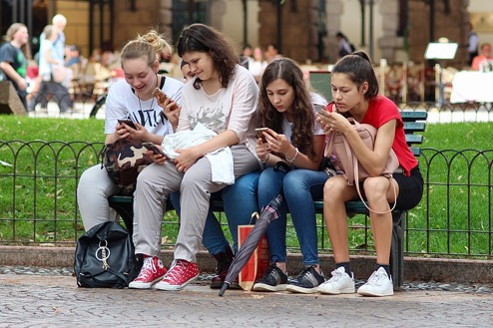
Mental health: challenges Anxiety, loneliness, old age, poverty, ill health, displacement, war, the impact of social media and bullying, postnatal depression… all these and more may affect our mental well-being.
Notes:
https://commons.wikimedia.org/wiki/File:Kurdish_Refuge_Camp_in_Suruc_Turkey.jpg
https://commons.wikimedia.org/wiki/File:Distracted_by_Phones.jpg
https://commons.wikimedia.org/wiki/File:Elderly_Woman,_B%26W_image_by_Chalmers_Butterfield.jpg
Again – sensitive handling needed here. Suggestions of factors that impact on mental well-being both in the UK and globally.

Slide 25
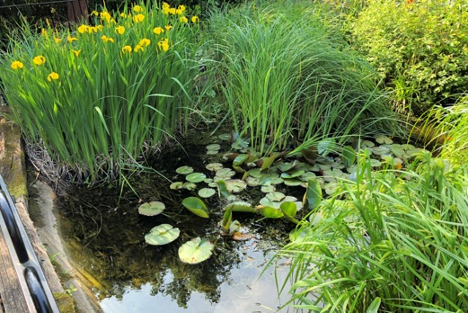
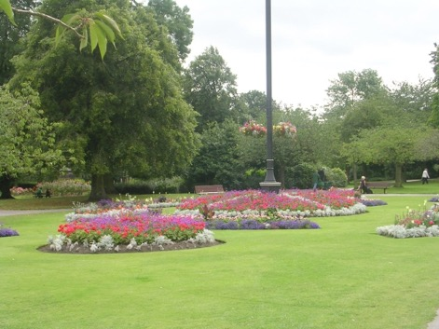
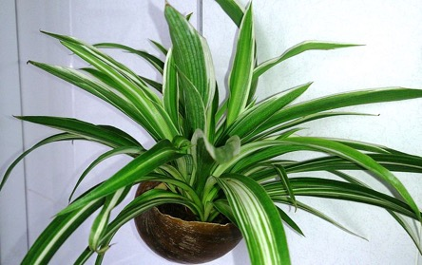
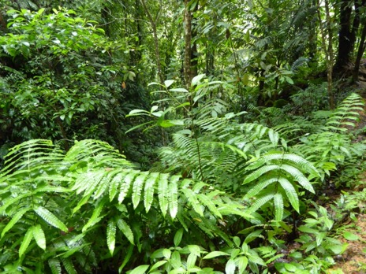
Mental health: solutions Evidence is growing that seeing plants in your home, a garden, a woodland or your local park has a major impact on mental wellbeing - even pictures of plants help!
Notes:
https://commons.wikimedia.org/wiki/File:Spider_Plant_%28Chlorophytum_comosum%29_1.jpg
https://commons.wikimedia.org/wiki/File:Flower_Beds_-_Pudsey_Park_-_geograph.org.uk_-_1455238.jpg
Pond and forest – credit Anthony Short.
Discuss the growing body of evidence showing the importance of exposure to plants for mental health and wellbeing. Students might investigate some of the work which shows really encouraging impacts on mental wellbeing with simple strategies that anyone can access for themselves.

Slide 26
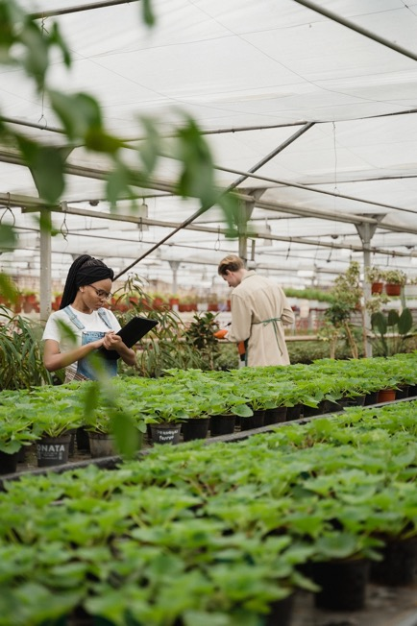
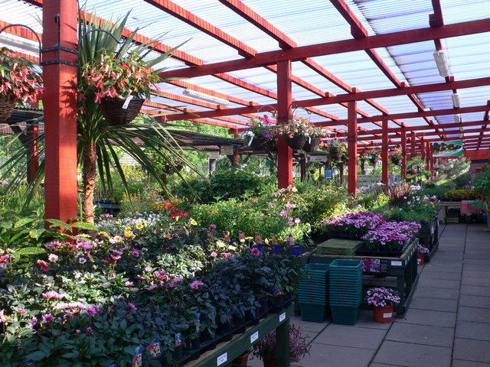
Mental health: solutions From plant nurseries to garden centres and florists, there are many careers helping people bring more plants into their lives.
Notes:
Nursery workers image by AJEET KUMAR from Pixabay
https://commons.wikimedia.org/wiki/File:A_tempting_display_at_Moreton_Park_Garden_Centre_-_geograph.org.uk_-_1386775.jpg.
Jobs working with plants give mental health benefits to the workers and to those who buy or see the plants. Students may well be unaware of the range of jobs in plant production in nurseries, garden centres and in areas such as growing lettuces, strawberries etc. for food.

Slide 27
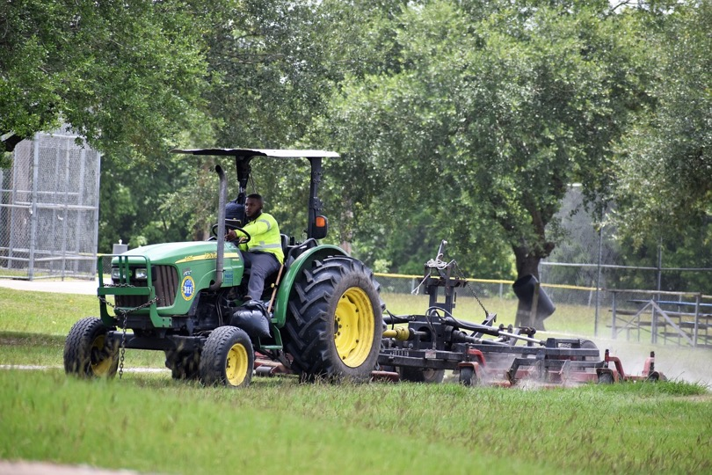
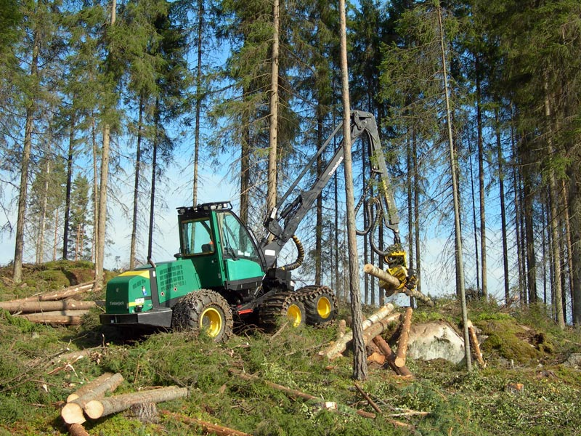
Mental health: solutions The work of gardeners, park workers, foresters and tree surgeons improve mental health for everyone who sees the results of their work.
Notes:
Lawn care image by F. Muhammad from Pixabay
Forestry https://en.wikipedia.org/wiki/Forestry#/media/File:TJ_harvesteri.jpg Credit: Heikki Valve, CC BY-SA 3.0, https://commons.wikimedia.org/w/index.php?curid=449982.
The evidence shows that walking in parks, gardens and woodlands has a big positive benefit for mental health – but it takes a lot of people working hard to provide these resources. Again, these are careers working with plants, some very physical and outdoors, others less so in management and planning, for example. Useful to make students aware of these opportunities.

Slide 28
Mental health: solutions Evidence shows that seeing plants makes people in care homes happier and healthier. In hospitals, patients who can see greenery leave hospital after surgery a day earlier. Roles from health care assistants to hospital managers have the potential to improve well-being by simply improving access to plants
Notes:
Care home room with plants and view credit Anthony Short
The impact of plants on health and recovery is only just being recognised by clear research evidence. It has been shown that patients who have a view of plants from a hospital bed or even just a large photograph of plants, a woodland etc. record less pain, need less pain medication, call the nurses less often and leave hospital up to 24 hours sooner after routine surgery. The impact of this simple knowledge on the ability of the health system to cope is potentially enormous. Care workers in homes, and staff in hospitals from management to medics, could all help their clients/patients feel better, and possible actually get better sooner, placing fewer demands of staff and beds, by simply following the evidence.

Slide 29
Mental health: solutions A balanced diet containing lots of plant-based food supports mental wellbeing resilience – growers, sellers, chefs and cooks, advertisers and dieticians all have a role to play in bringing more plants into our lives
Notes:
https://commons.wikimedia.org/wiki/File:Nutrition-pyramid.jpg.
Fruit/vegetables and olive oil images credit Anthony Short.
You are what you eat! There are huge numbers of careers in providing good, plant-rich food for as many people as possible, ranging from scientists investigating the best plant-based food to eat, to dieticians who plan the meals served in schools, hospitals and prisons and everyone who grows, sells or prepares plant-based foods in homes, restaurants and supermarkets.

Slide 30
Mental health: solutions Building the evidence for the role of plants in good mental health depends on research scientists, technicians and the statisticians and data analysts who make sense of all the results.
Notes:
https://commons.wikimedia.org/wiki/File:Genebank4_%284331057760%29.jpg;
https://commons.wikimedia.org/wiki/File:Researcher_looking_through_microscope.jpg;
https://commons.wikimedia.org/wiki/File:Wiki-statistics_01.jpg.
People who build the evidence behind all the advice we are given on how plants impact our health are not all juggling plants and apparatus in laboratories. Computer experts and statisticians also play a key role in helping us understand what is going on – in science today, computers and the ability to manage big data are key skills which students may not be very aware of.

Slide 31
The problems of plastics: challenges Plastics are incredibly useful – cheap, light and strong. But we use fossil fuels to make them, and most do not break down naturally and cannot be recycled. Plastic is polluting our world both when it is made and when we have finished using it.
A UK garden bird’s nest
An isolated Caribbean beach
Notes:
All images credit Anthony Short.
Discuss the value of plastics with students. They have many positive characteristics – which is why they are so widely used. Question why they are so damaging environmentally both in terms of production and life cycle but also consider how they help avoid food waste etc. This slide and the next one show just some of the places that plastic waste turns up globally.

Slide 32
The problem of plastics: challenges
Piles of plastic waste in Thilafushi, the Maldives
From the stomach of an albatross in New Zealand – spot the toothbrush!
Notes:
https://commons.wikimedia.org/wiki/Category:Plastic_waste#/media/File:Piles_of_plastic_waste_in_Thilafushi,_2012_(2).jpg
Albatross stomach contents Anthony Short
More examples of plastic waste – ask students for suggestions of how plants might be able to reduce our dependence on plastics. Look for more use of paper and card as well as bioplastics.

Slide 33
The problem of plastics: solutions Materials scientists and designers are developing plastics based on starch and cellulose, compounds sourced from plants. But the solution isn’t always easy…
Polylactic acid is made from
fermented plant starches and has many uses but it is not easily decomposed
Notes:
https://en.wikipedia.org/wiki/Biodegradable_plastic#/media/File:Cmglee_PLA_cups.jpg credit: By Cmglee - Own work, CC BY-SA 4.0, https://commons.wikimedia.org/w/index.php?curid=83224814.
Just because plastics are made from plant-sourced compounds doesn’t mean they will decompose easily in the natural world. Students can explore the fact that all of these challenges and solutions are not black and white and include many shades of grey.

Slide 34
The problem of plastics: solutions Other bioplastics – like this potato starch-based wrapper- are easily decomposed, even in a home compost bin. Cardboard and paper are also sustainable alternatives to plastic and are often recyclable.
Notes:
Image credit Anthony Short.
Bioplastics (and alternatives such as card and paper) are not a simple solution. Help students see that arguments such as this are not black and white. Challenges include the range of uses e.g. card and paper need to be waxed to be waterproof. Commercial waxes are often made from petrochemicals so manufacturers must use natural waxes and then cost and availability are an issue. There is conflict between uses of plant resources when globally people still go hungry, biomass as a sustainable energy alternative and plants being needed to absorb carbon dioxide from the atmosphere. There is a huge range of potential careers both now and going forward to find alternatives to plastics and plants are going to play a big part in this.

Slide 35
The problem of plastics: solutions More plant-based plastics need to be developed, the plants to provide the raw materials must be grown, and people must be convinced to use them around the world. There are lots of plant-related jobs here!
Notes:
Rain forest credit Anthony Short
Lab: https://commons.wikimedia.org/wiki/File:InvestigadoresUR.JPG;
There are many different potential careers helping to replace plastic in modern lifestyles. Many of these roles will involve working directly or indirectly with plants. They certainly do not all involve becoming a professional scientist, but it is very helpful to make students aware that a good grasp of basic plant science will always help!

